Slide 1
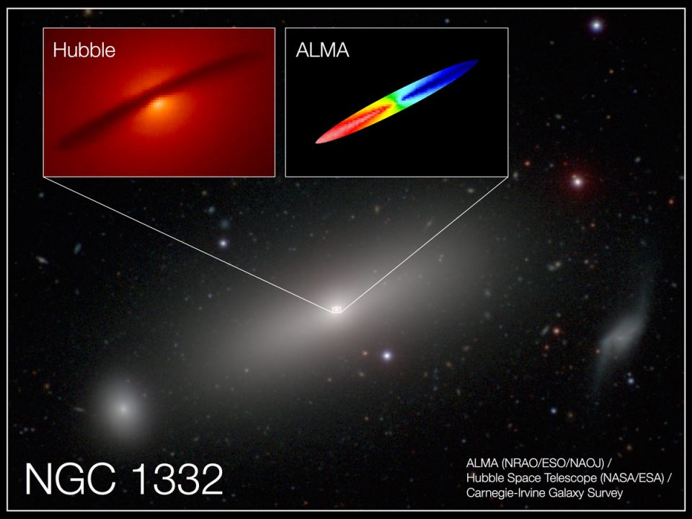
Notes:
A group of scientists from the U.S. and China, including Dr. Jonelle Walsh at Texas A&M, used a radio telescope called ALMA, located in the Atacama Desert of Chile at about 15,000 feet of altitude, has been used to make the most precise measurement of the mass of a supermassive black hole.
They measured the speed of carbon monoxide gas that is orbiting the black hole in the very heart of a giant elliptical galaxy. The disk of gas is 1600 light years in diameter, but the gravity of the black hole is distinct only in the innermost 80 light years.
ALMA's unprecedented resolution allowed the team to look into the innermost 80 light years, where the gravity of the black hole dominates, to measure the mass of the black hole to within 10%.
<number>

Slide 2
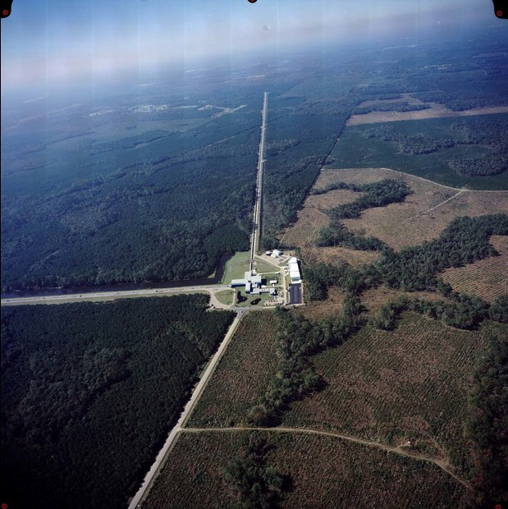
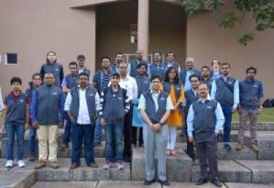
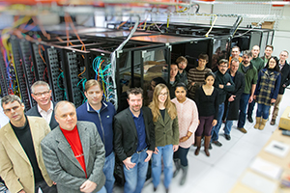
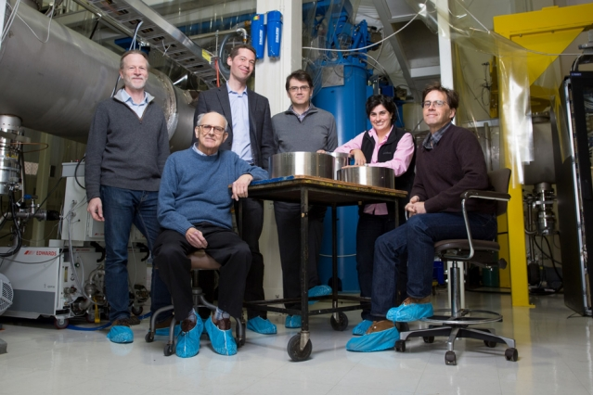
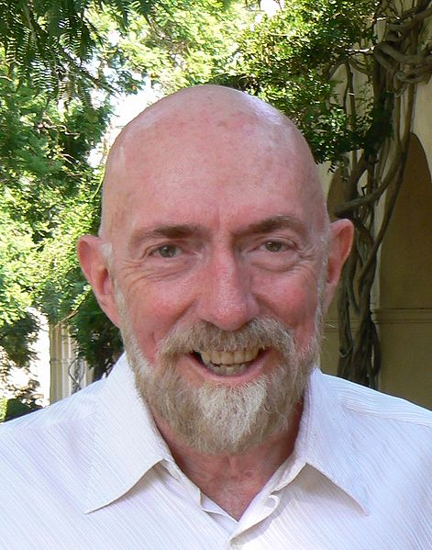
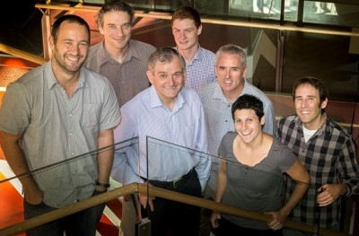
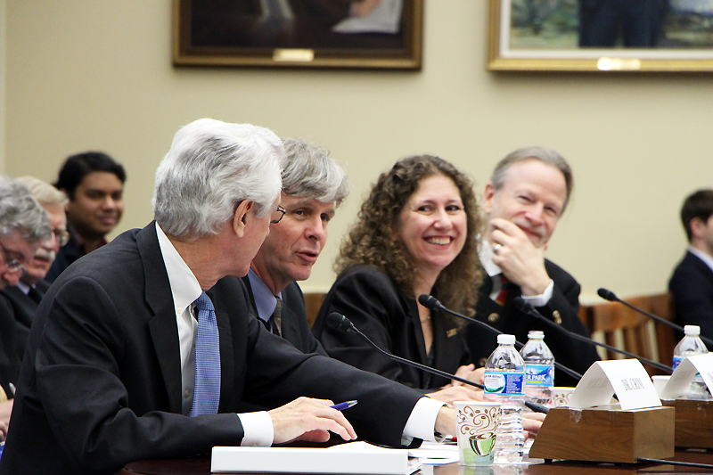
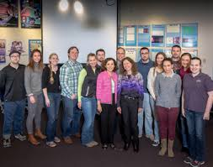
Notes:
A Special Breakthrough Prize of $3 million was given to the LIGO collaboration for their recent detection of gravitational waves from merging black holes.
Of the $3 million, $1 milllion is split between the three founders of the project, Ronald Drever, Kip Thorne, and Rainer Weiss. The remaining $2 million is split between the 1012 authors and contributors of the project, including scientists at Texas Tech, UT-Rio Grande Valley, Trinity University in San Antonio, and Abilene Christian University and former AoTATX speaker Nullifier of Noise (Dr. Dennis Ugolini).
Sorry, we couldn't fit all 1015 scientists on the screen.
The award was funded by Yuri Millner, a Russian entrepeneur who was in the news last month for starting a project to send microsats to Alpha Centauri.
<number>

Slide 3
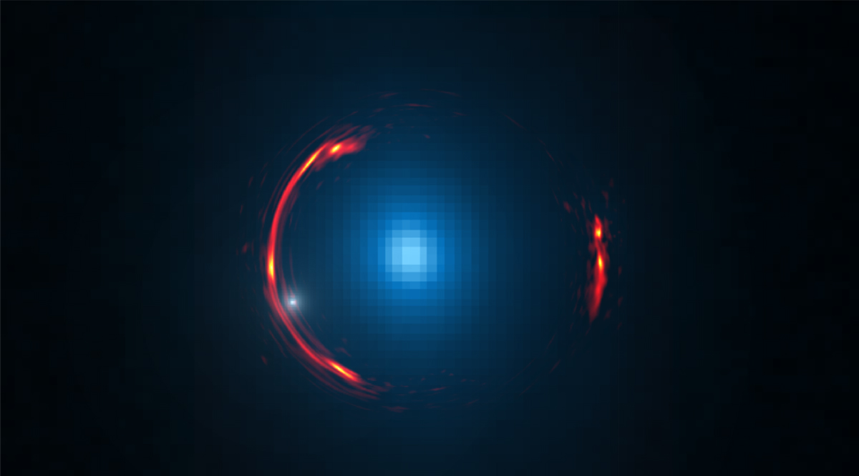
Notes:
ALMA was also used to detect a dwarf dark galaxy, with a mass of about 1 billion suns, only a little bigger than the mass of the black hole that the other team measured!
The study used gravitational lensing, which our own MC High Z and several other AoTATX speakers have talked about, where the gravity of a relatively nearby galaxy bends the light of a galaxy that is behind it, making the distant galaxy easier to see.
Here, the the relatively nearby galaxy, actually 4 billion light years away from us, is blue and the distant galaxy is seen as the distorted, red galaxy. The dwarf galaxy is near to the blue galaxy and was detected by the subtle distortion it causes in the image.
<number>

Slide 4
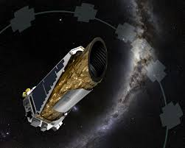
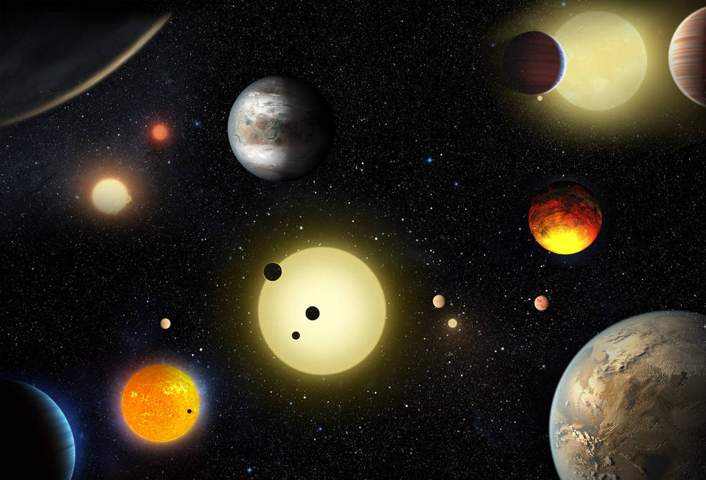
Notes:
The Kepler mission was in the news twice this month.
The Kepler spacecraft had gone into emergency mode on Apr 8. After working tirelessly for two weeks the mission team got the telescope working again on the morning of April 22. It is in the second phase of the mission, still looking for planets around distant suns.
The team just announced on May 10 the confirmation of 1284 new planets discovered by Kepler, bringing the total up to over 3000.
Of these 1284 new planets, 550 could be rocky like Earth, and 9 may be habitable. Now we just need to figure out how to get there.
<number>

Slide 5
Notes:
JWST folded up
<number>

Slide 6
Notes:
Mercury transit
<number>

Slide 7
Notes:
Pluto map
<number>

Slide 8
Notes:
Heart shaped sunspot
<number>

Slide 9
Notes:
MakeMake moon
<number>

